Slide 1
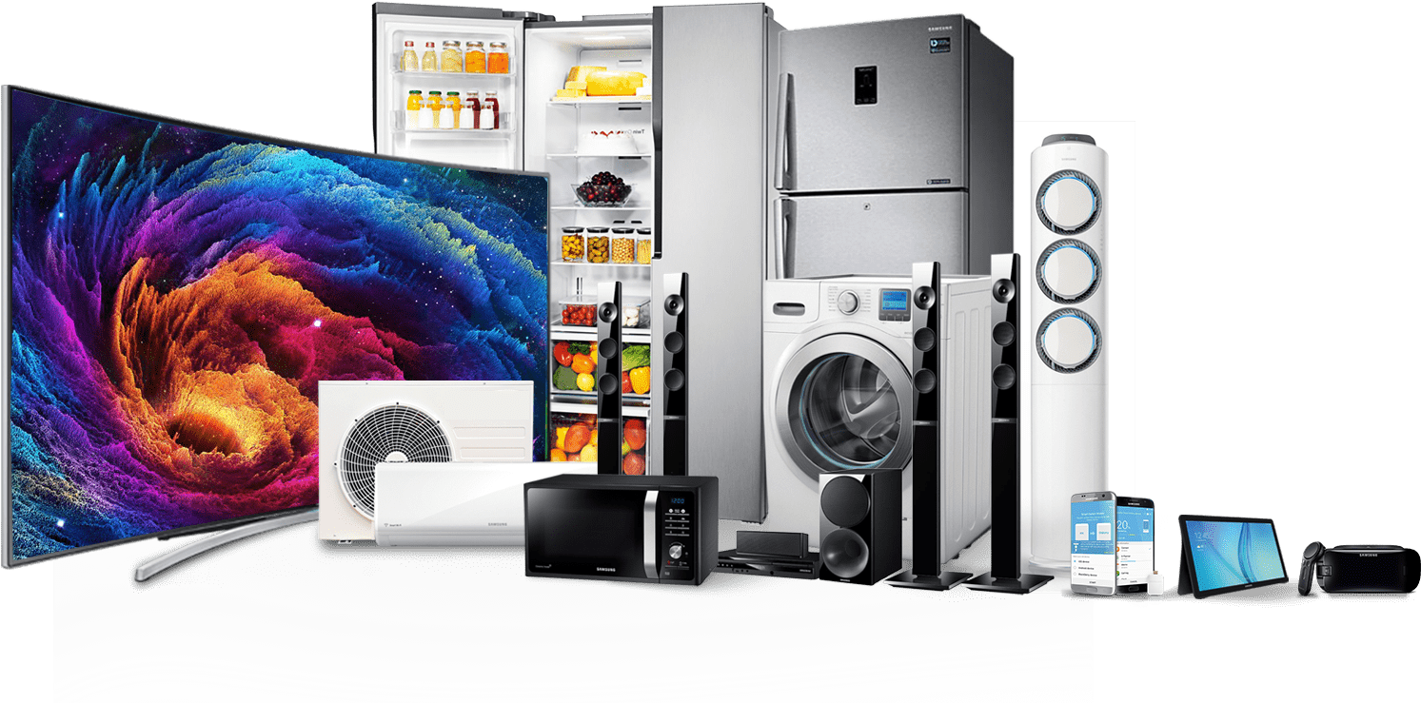
Electronic Warehouse Inventory
Team Members:
Saikiran Meradikonda

Slide 2
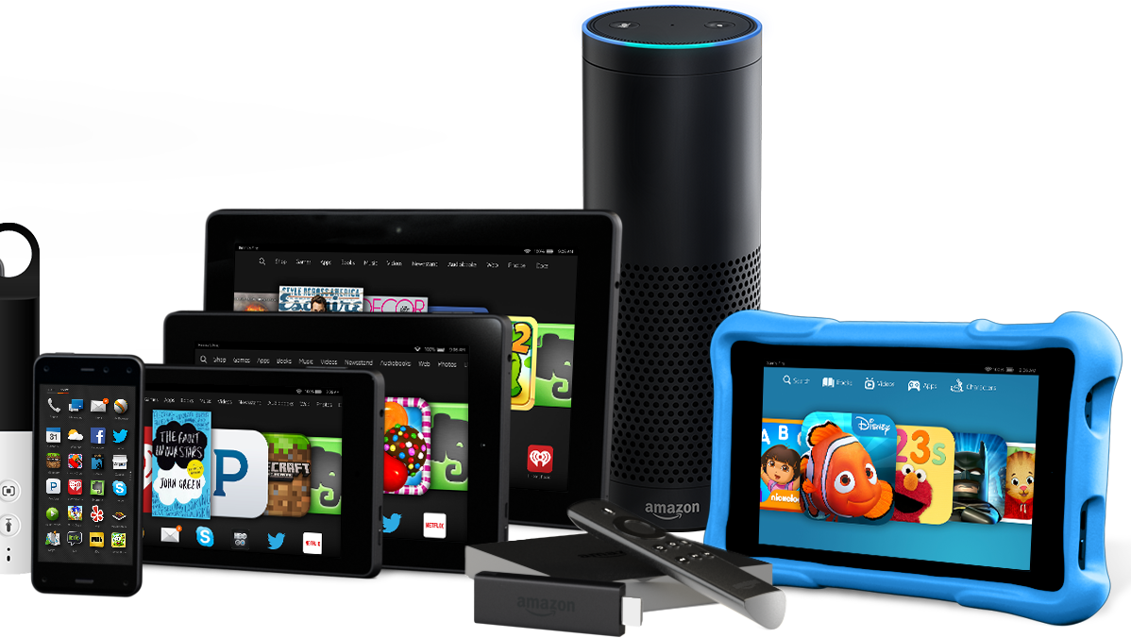
Objective
Develop a web application for customers who wants to purchase electronics online by saving time.
Admin logs in and can view different categories of products.
Admin can add the new products to the website.
Customer logs in and go through the menu which has different product categories.

Slide 3
Product Backlog
ID | Story | Estimation | Priority
PB1 | As a customer, I want to create a profile by providing following details: Name of the organization, address, email, phone, registration number, contact person name, contact person email, contact person number, username, password and confirm password. | 2 | 4
PB2 | As an admin, I want to login/logout on the website | 1 | 1
PB3 | As a customer, I want to login/logout on the website | 1 | 5
PB4 | As an admin, I want to perform CRUD operations on the products on the website | 5 | 3
PB9 | As a customer, when I click on the menu bar it should display all the product categories. | 1 | 6
PB10 | As an admin, when I click on the menu bar it should display all the product categories and add products options. | 2 | 2
PB19 | As a Customer/admin, I want to see the contact information, details about the company and copyrights in the footer. | 1 | 1

Slide 4
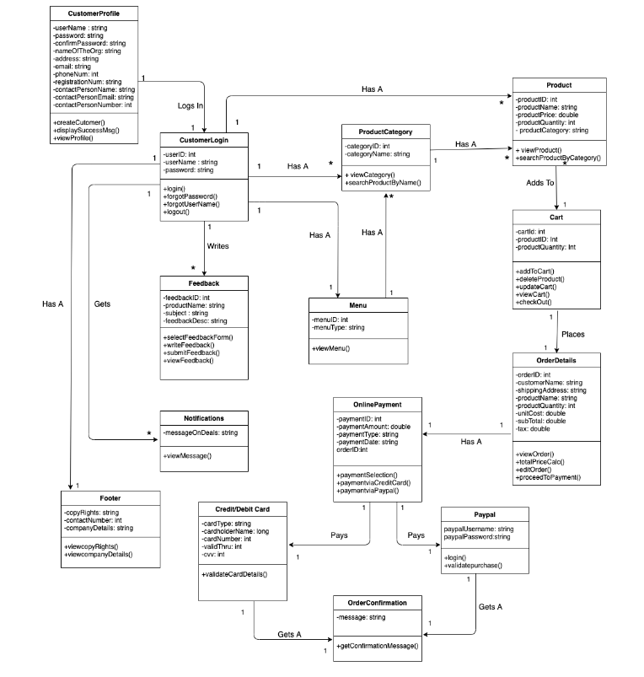
Customer Class Diagram

Slide 5
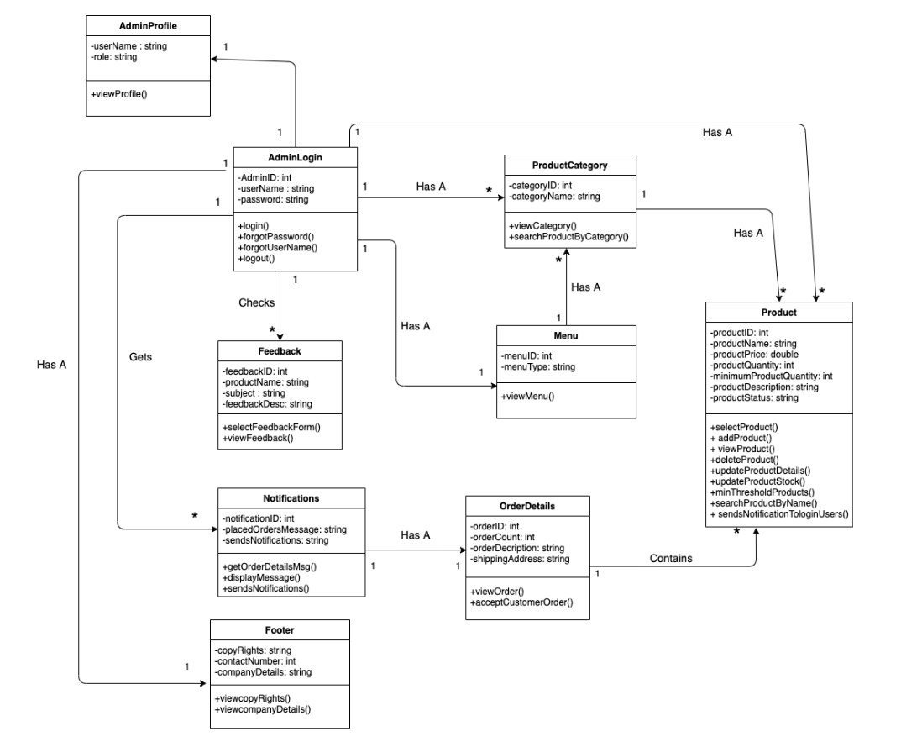
Admin Class Diagram

Slide 6
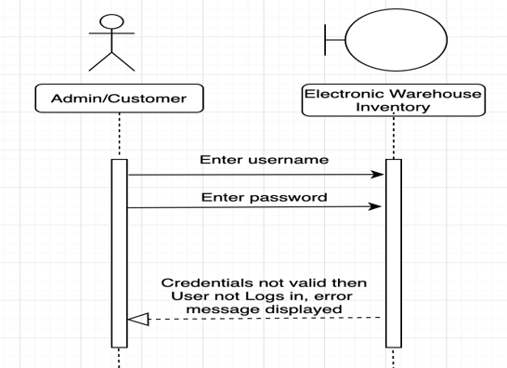
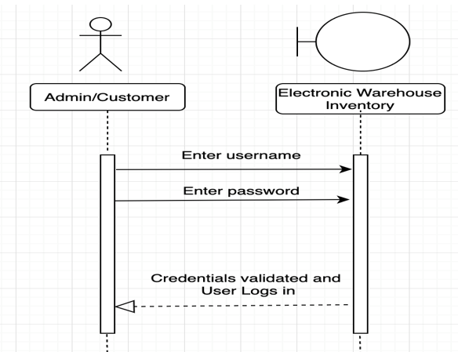
Interaction Diagram for Login Process

Slide 7
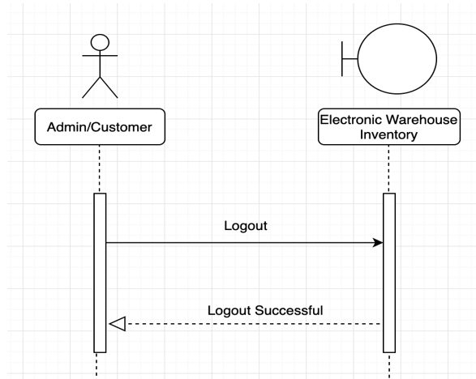
Interaction Diagram for Logout Process

Slide 8
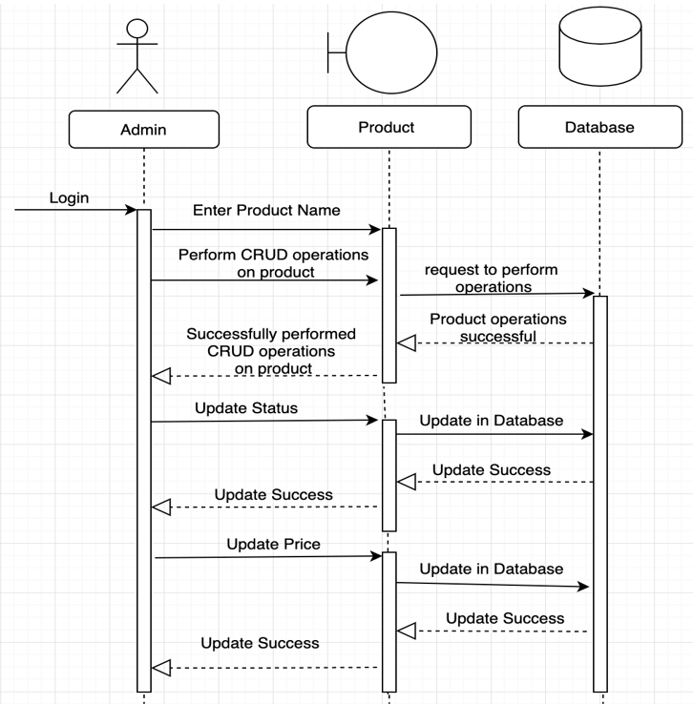
Interaction Diagram for performing CRUD operations on Products

Slide 9
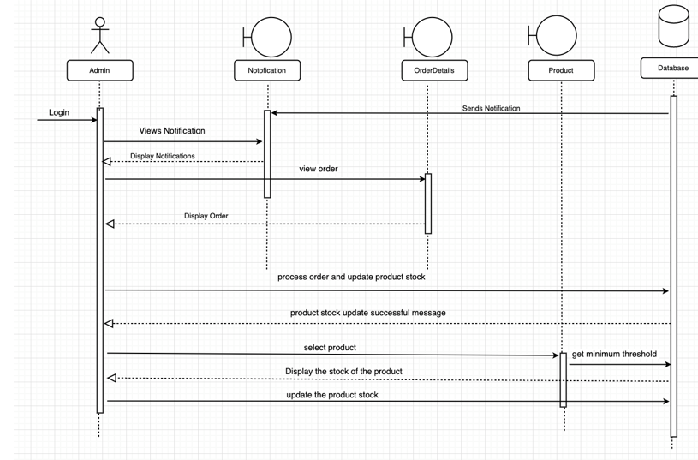
Interaction Diagram for Stock Update Process

Slide 10
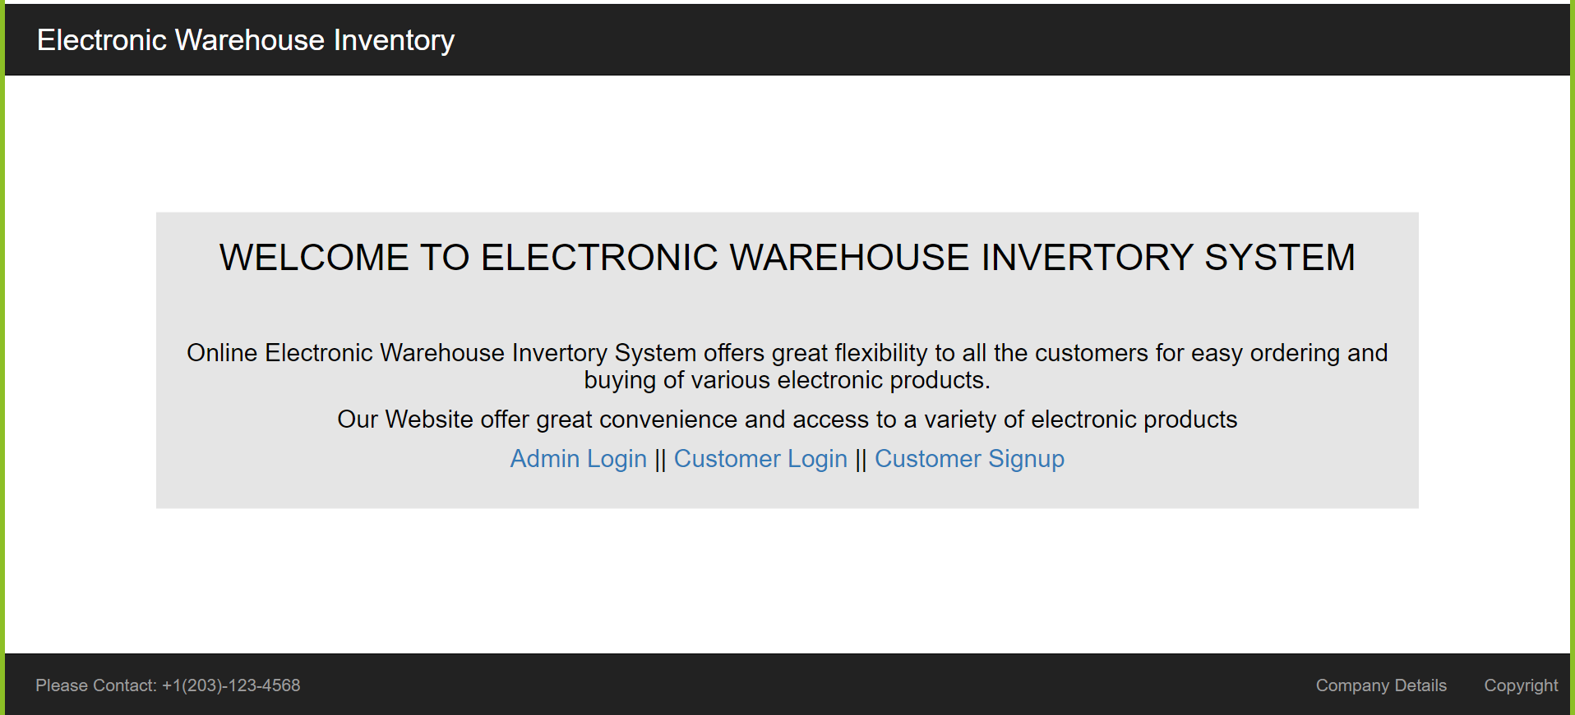
Home Page

Slide 11
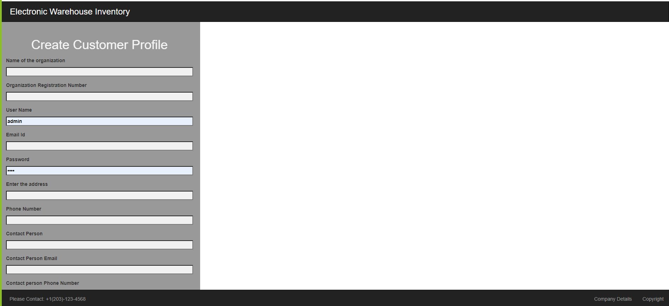
Create Profile for Customer

Slide 12
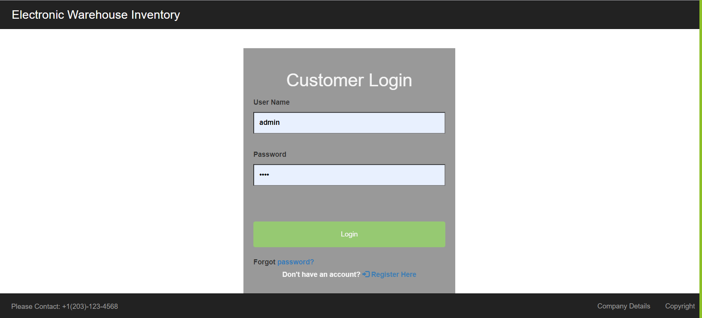
Login Page

Slide 13
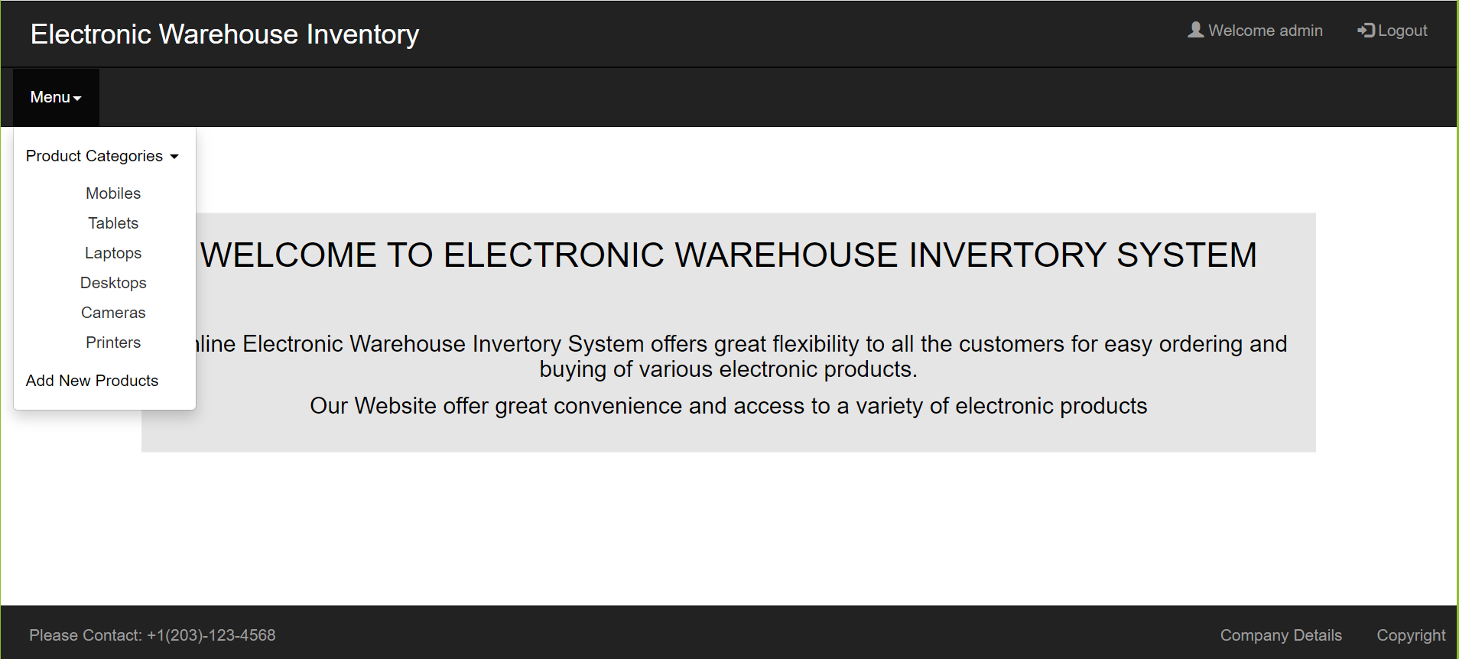
Landing page with menu option after login

Slide 14
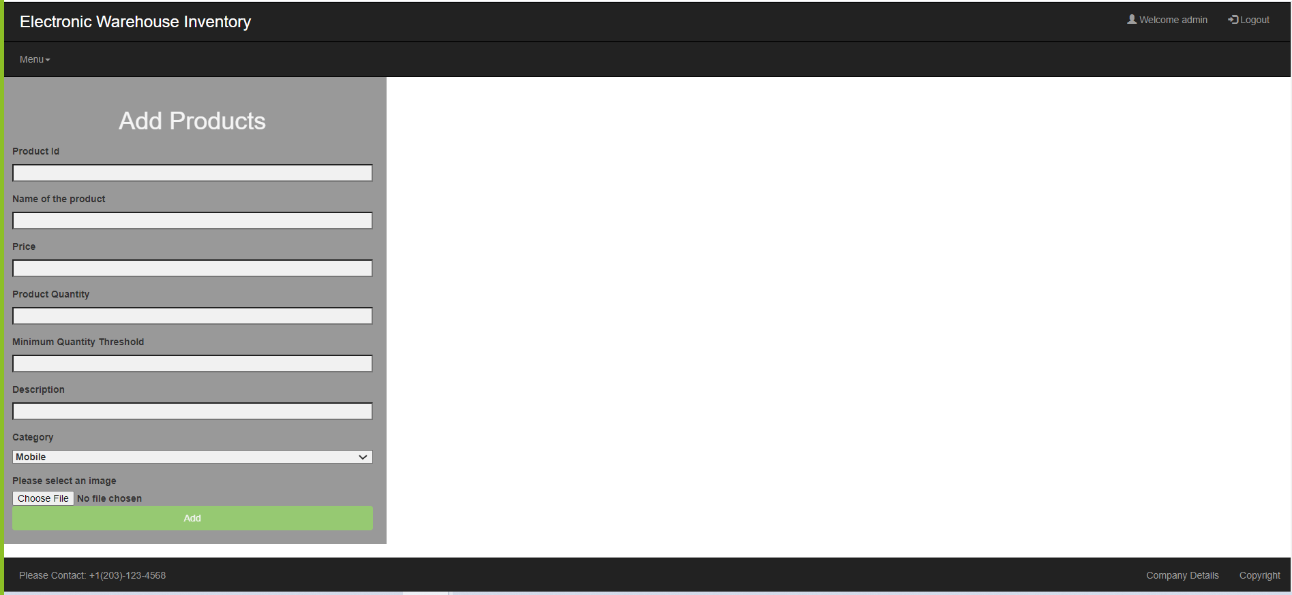
Add Product Page

Slide 15
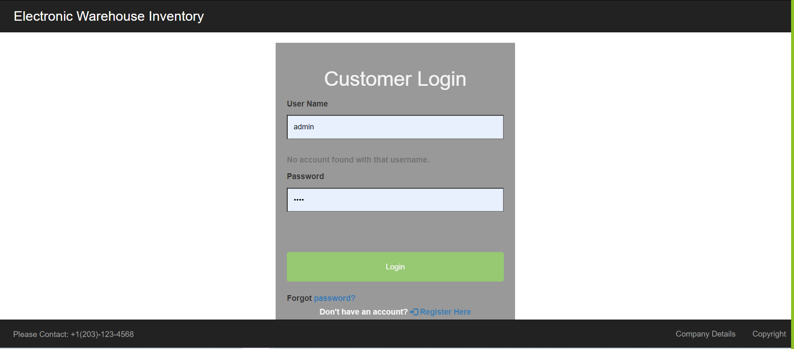
Invalid Login Page

Slide 16
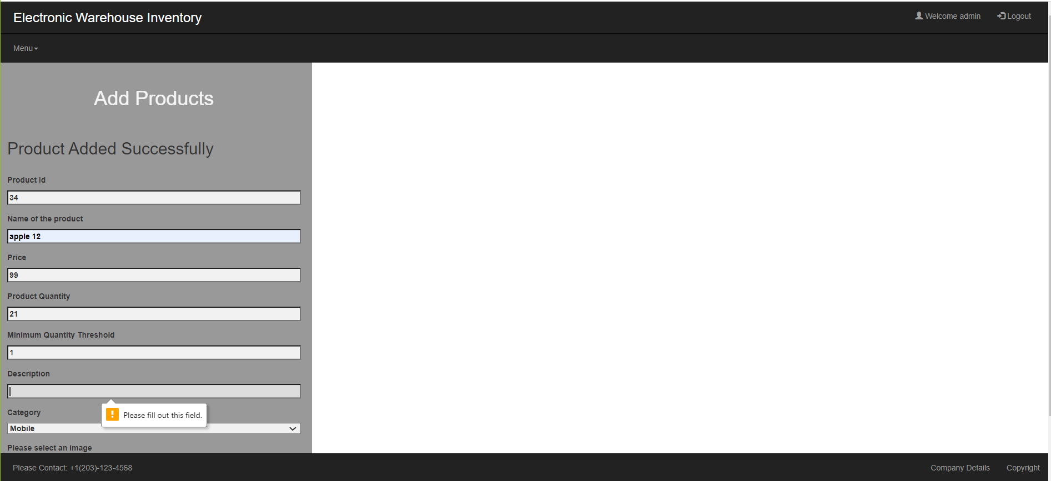
Invalid Add Products Page

Slide 17
Retrospective
What worked well
Completed the initial process which is required to kick start the website development
Conducted daily stand-up meetings so that every team member would be aware of day-to-day progress.
Completed 95% of sprint stories.
What didn’t work well
Had a minor misconceptions while electing the programming language to proceed further with the project.
Time allocated to develop the features of the website was not estimated appropriate and ended up spending twice more time on it.
Couldn’t complete the delete operation on product.
Lessons Learned from this phase
Got familiar more with agile methodology.
Got to know new coding methodologies and its implementations.
Impact on the project
Stretched ourselves to work for more hours to complete the expected outcomes correctly on time within the deadline.

Slide 18
Objective
Develop a web application for customers who wants to purchase electronics online by saving time.
Admin logs in and can view different categories of products.
Admin can perform CRUD operations on the products.
Customer logs in and go through the menu and can view the products from different product categories.
Customer can add the products to the cart.

Slide 19
Product Backlog for last Sprint
ID | Story | Estimation | Priority
PB1 | As a customer, I want to create a profile by providing following details: Name of the organization, address, email, phone, registration number, contact person name, contact person email, contact person number, username, password and confirm password. | 2 | 4
PB2 | As an admin, I want to login/logout on the website | 1 | 1
PB3 | As a customer, I want to login/logout on the website | 1 | 5
PB4 | As an admin, I want to perform CRUD operations on the products on the website | 5 | 3
PB9 | As a customer, when I click on the menu bar it should display all the product categories. | 1 | 6
PB10 | As an admin, when I click on the menu bar it should display all the product categories and add products options. | 2 | 2
PB19 | As a Customer/admin, I want to see the contact information, details about the company and copyrights in the footer. | 1 | 1

Slide 20
Product Backlog for current Sprint
PB5 | As an admin, I want to update the prices and status of the products | 3 | 8
PB16 | As an admin, I want to verify and check the stock if any particular product is less than the certain threshold (minimum limit of the product quantity given by the admin), then those products are displayed in a separate section. | 3 | 7
PB18 | As a Customer/admin, I want to see the Company's Logo, profile, notifications, feedback, search bar and Logout in the header. (Cart option for customers only) | 1 | 8
PB7 | As a customer, I want to navigate through the website so that I can select one and see the details and can add the item to the cart. | 3 | 9

Slide 21
Customer Class Diagram

Slide 22
Admin Class Diagram

Slide 23
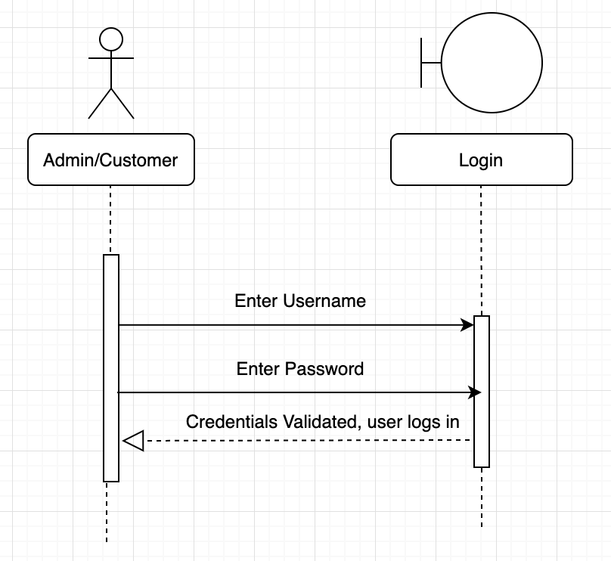
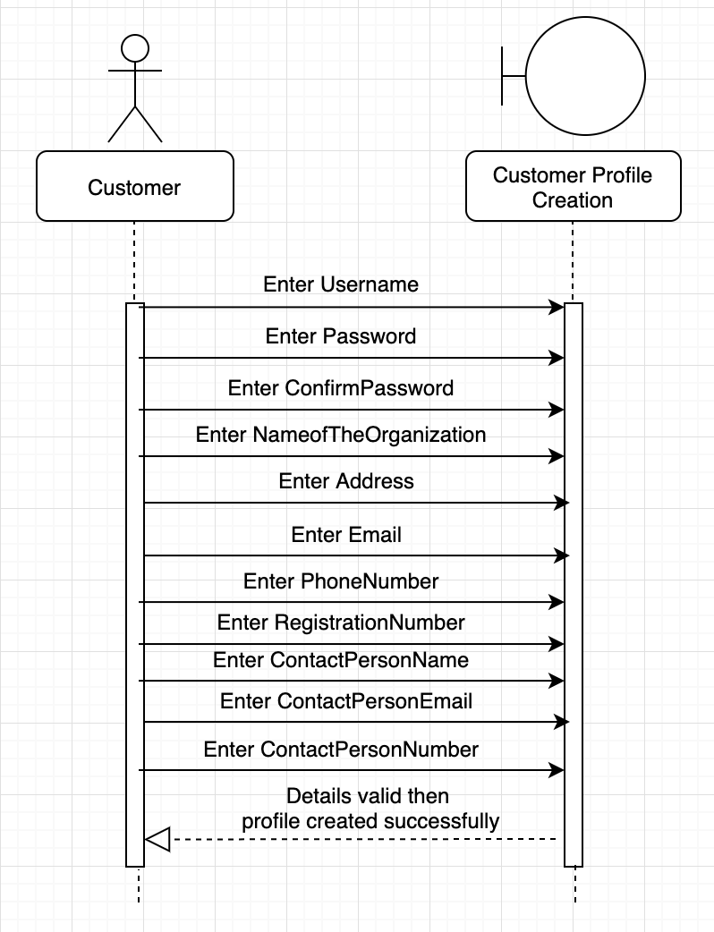
Interaction Diagram for Customer Profile & Login Process

Slide 24
Interaction Diagram for performing CRUD operations on Products

Slide 25
Interaction Diagram for Stock Update Process

Slide 26
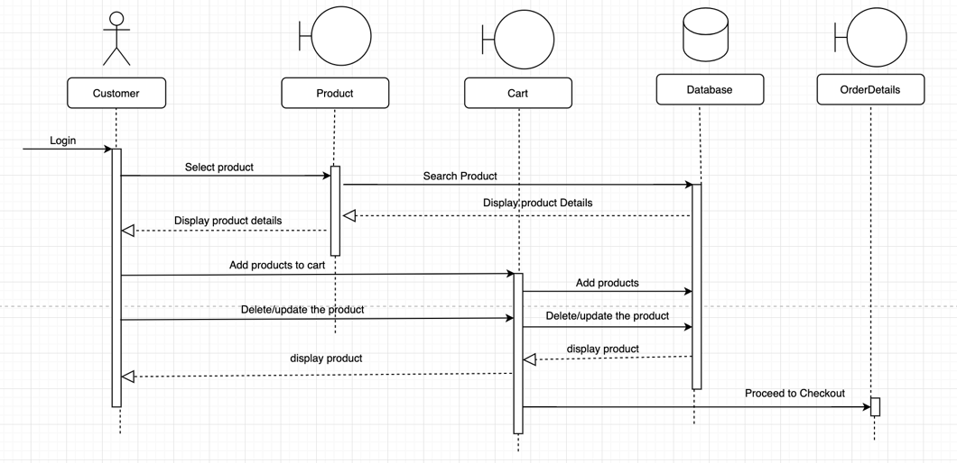
Interaction Diagram for Process Add to Cart

Slide 27
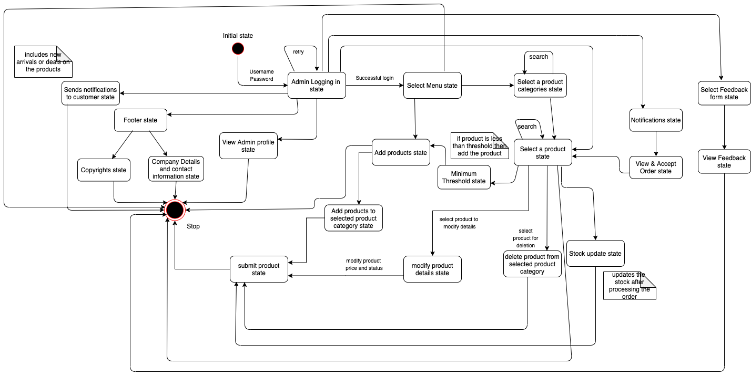
State Diagram for Admin

Slide 28
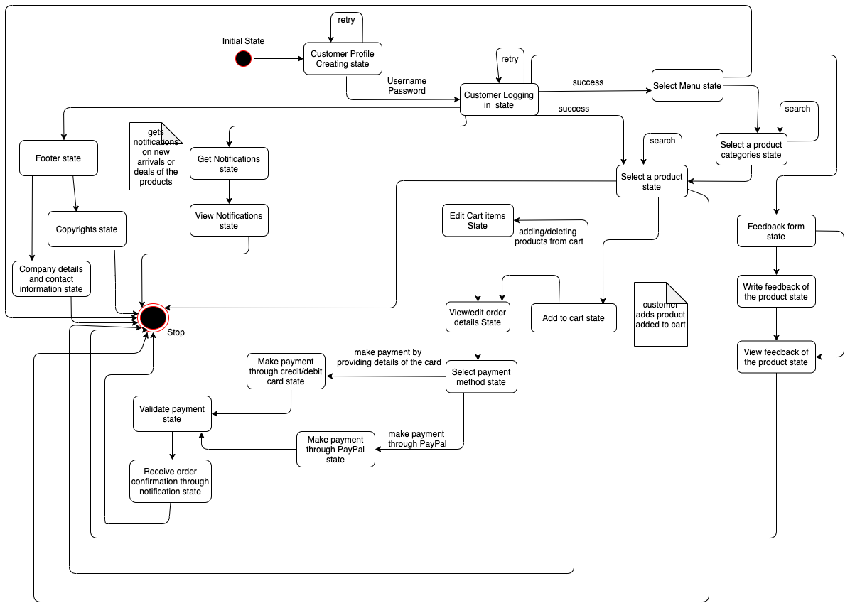
State Diagram for Customer

Slide 29
Home Page

Slide 30
Create Profile for Customer

Slide 31
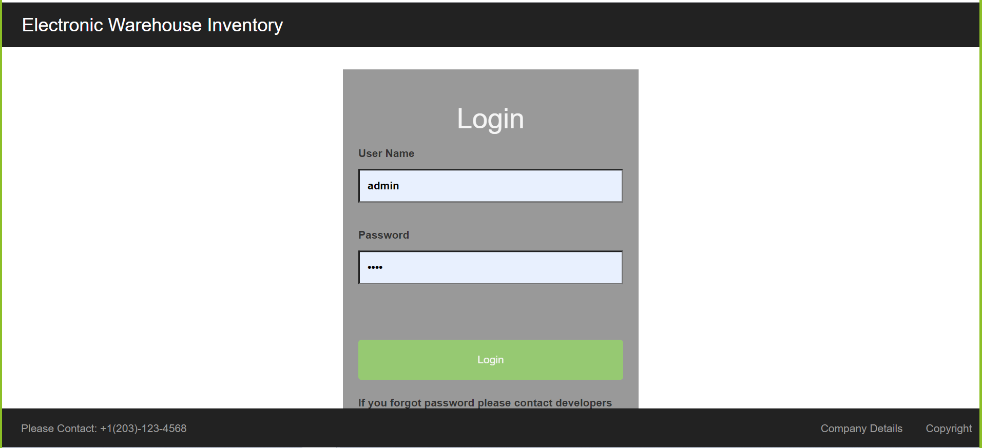
Login Page for Admin

Slide 32
Add Product Page

Slide 33
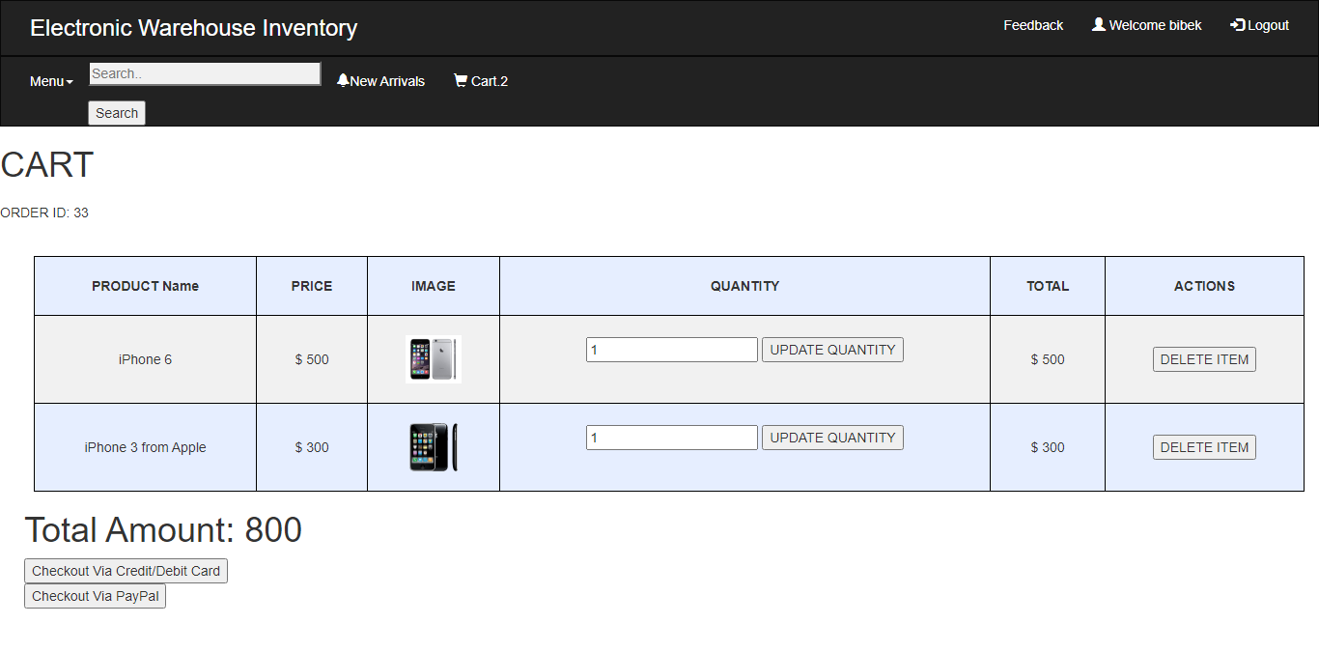
Add Products to Cart Page

Slide 34
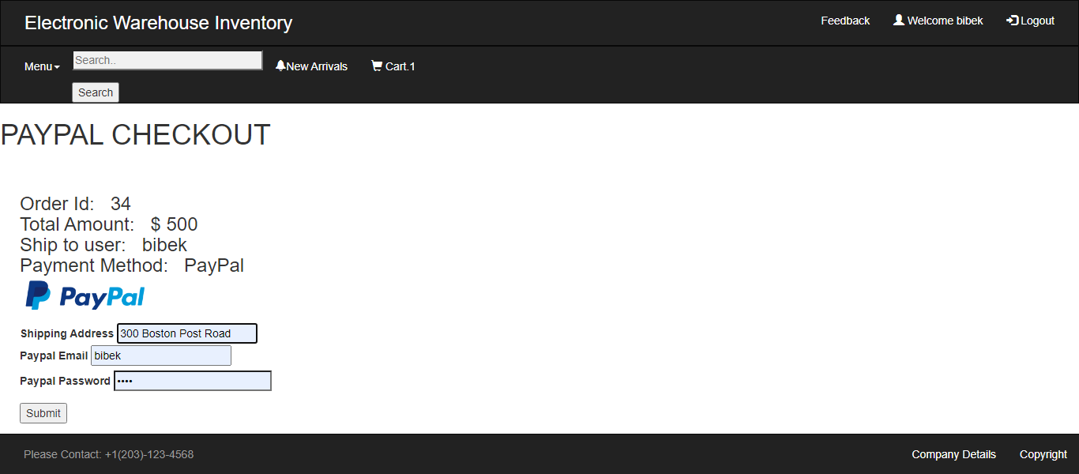
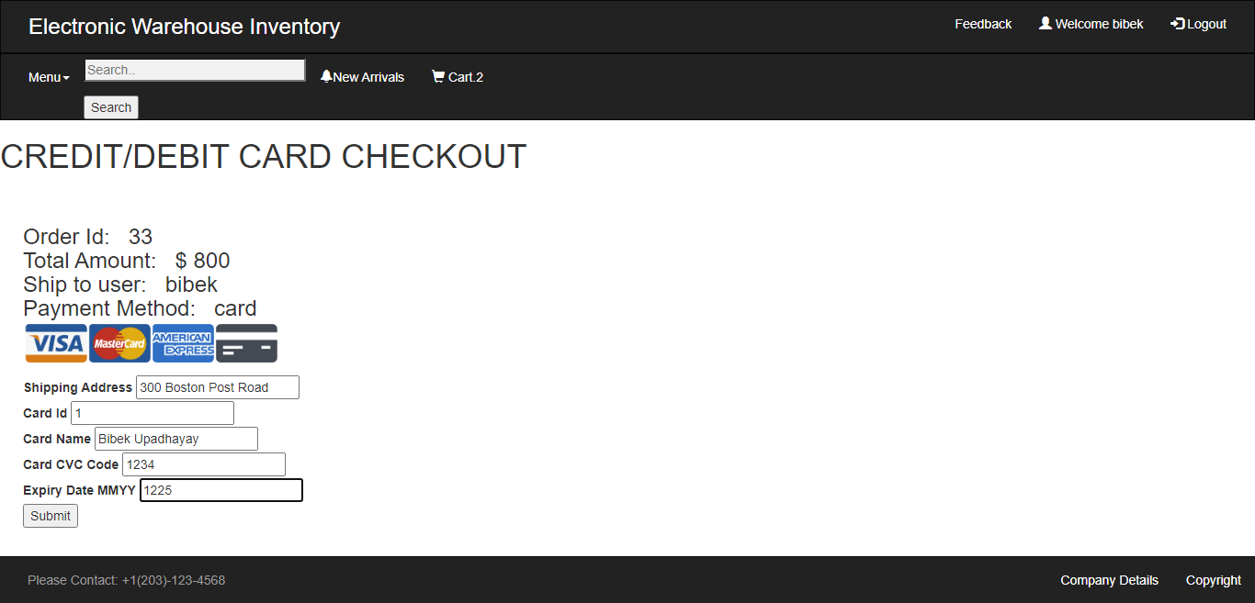
Checkout Using Credit/Debit card & PayPal

Slide 35
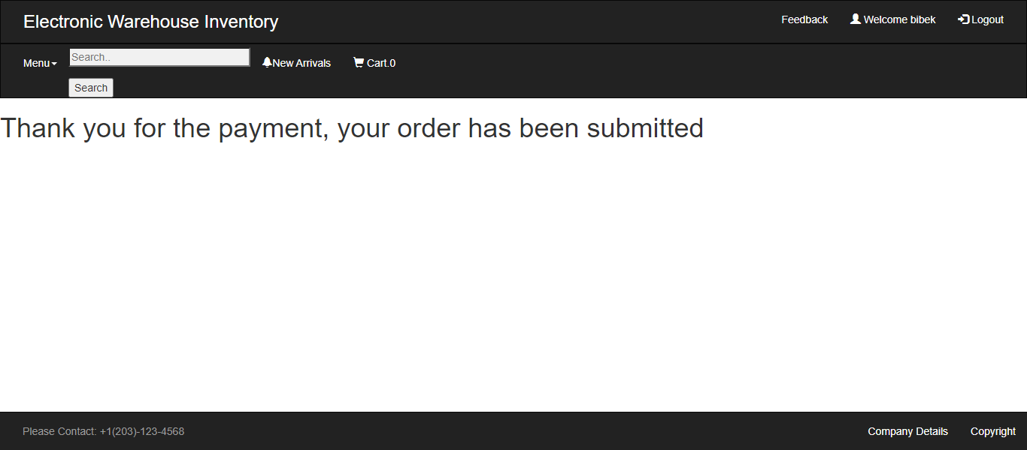
Order Confirmation

Slide 36
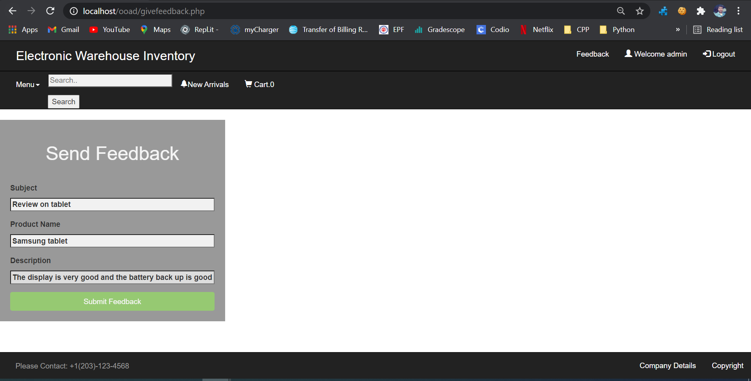
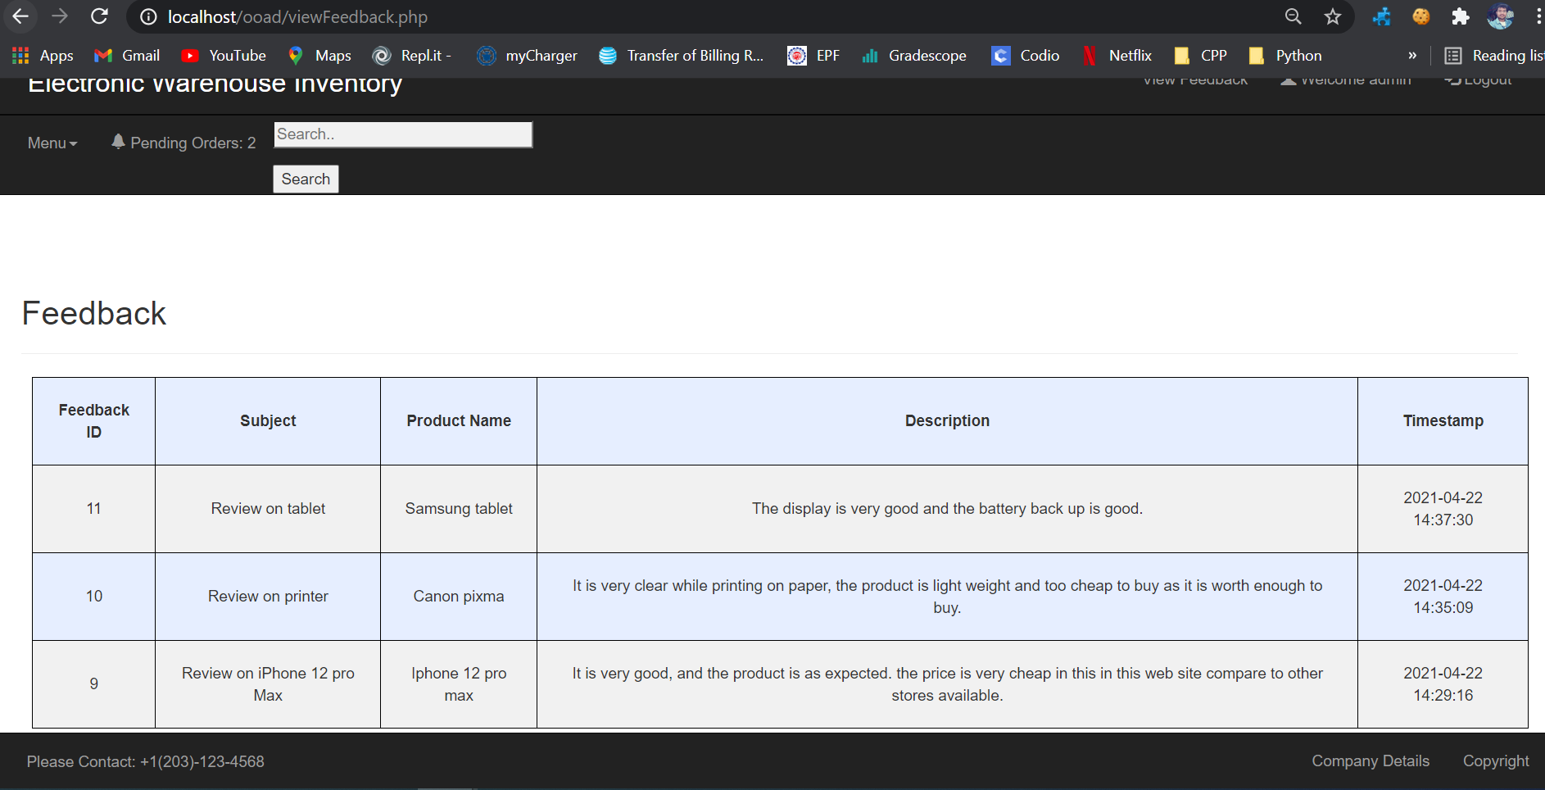
Feedback

Slide 37
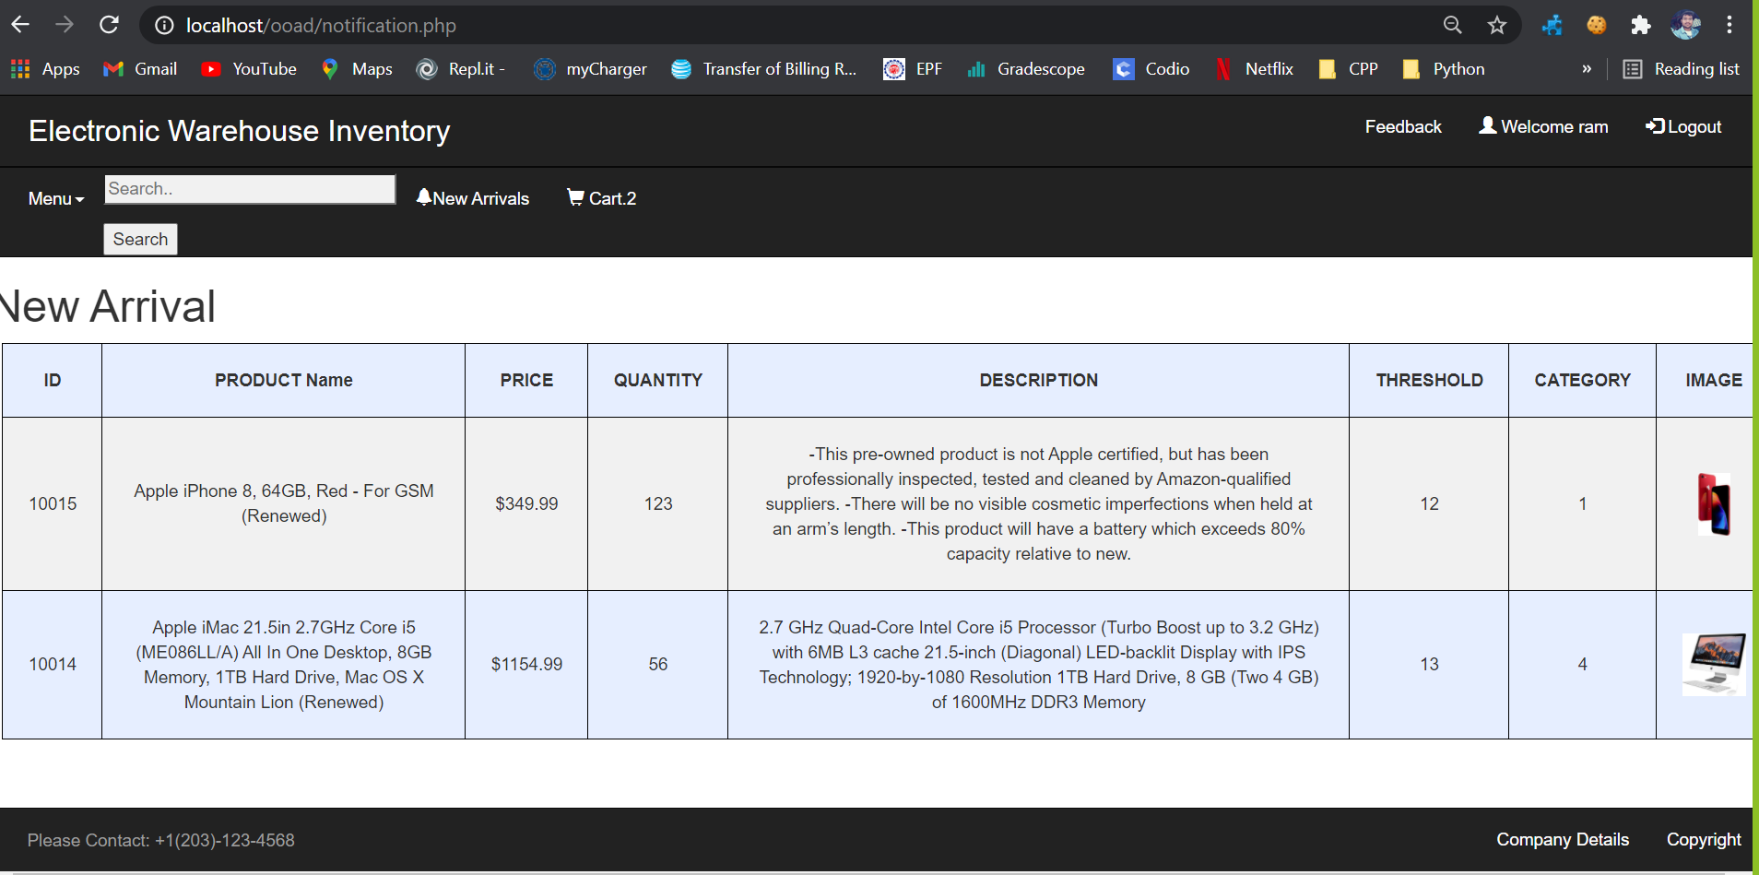
Notifications for New Arrivals

Slide 38

Future Enhancements
We will add the payment gateway by including all the third-party payment services with all approvals.
We will make it available for both iOS and Android.
We will work on the reports such that the admin will know whether his business is in profit or in loss.

Slide 39





Tools Used

Slide 40
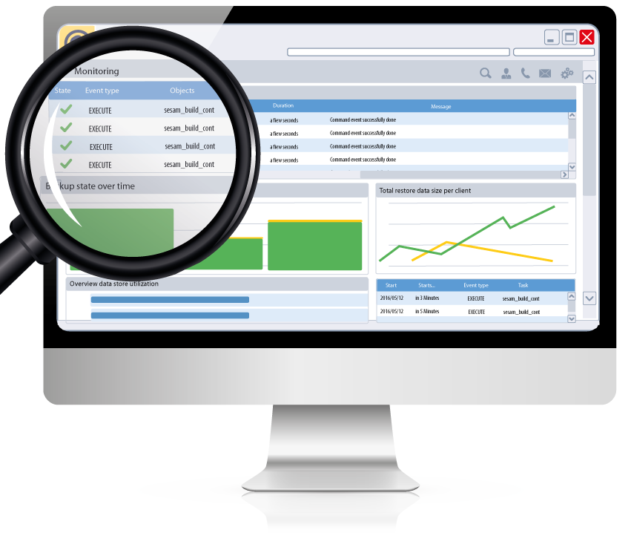
Live Demo

Slide 41


